Slide 1



Slide 2

Smart Quiz Manager
Supervised by:
Dr. Shehzad Faisal
Group Members:
Muhammad Hammad Ali ( SP17-BCS-021 )
Muhammad Hamza Islam( Sp17-BCS-023 )
Presented on December, 2020
Department of Computer Science
COMSATS University Islamabad
Attock Campus

Slide 3
Outline
_______________________________
Introduction
Related Work / Applications
Problem statement
Objectives
Methodology
Modern tools
Benefits
Use Case diagrams
System Screen Shots
Future work
Conclusion
______________________________

Slide 4

Introduction
As much as most local institutions of learning have hold E-learning to assemble the bar some of institutions have choose an online examination system, in fact little has been done in development of online systems.
It becomes necessary for the coordination of people in a modern firm. “Smart Quiz Manager” is very helpful for Institutions to prepare an exam and save the time.

Slide 5
Continued...
It used to enhance the strategy for conducting the exams and for getting best results in little time.
In-built mechanism which stops participants from typical exam malpractices like copying from others or bringing cheats-sheets.
In case of accidental termination of the tests, system will generate a message that the test is cancel. All major types of questions can be created.

Slide 6
Related Work / Applications
Name | Weakness | Proposed Project Solution
Quiz-Maker(website)[1] | Lack of security check Answer checking is not available | Our system will provide the complete secure platform from cheating
Nexquiz(website)[2] | Lack of security check Answer checking is missing | Our system will provide static screen during quiz
ClassMaker(website)[3] | Lack of security check Cannot export or print | This system will provide to print the paper after creating.

Slide 7
Problem Statement
Although there are some websites or platforms that are providing the facility to create a quiz, but the main problem is that there is no management or invigilation of the quiz.
Also there is no satisfactory auto checking system for subject questions.

Slide 8
Objectives
The main aims and objectives of our system are
as under :-
Make an efficient and rich system for exam invigilation and paper checking.
To provide a security system for user authencity.
To allow automatic checking.

Slide 9
Methodology / Features
The methodology used by us is as under:
Using webcam and monitoring mouse and keyboard activities and maintaining a log file.
Using cosine similarity checker and n-gram to check the quiz.
Generate a quiz report by having threshold on similarity of quiz with the given answers in the database.

Slide 10
Continued...
Record keys and mouse activities in log file.
Provide a secure online examination system free of cheating.
Automatically terminate or cancel the examination if the movement of student is suspicious(Static screen during quiz)
Take a picture via web cam to match the pictures with the profile if feel defaulted than the quiz will cancel.

Slide 11
Methodology cont…
We use the spiral method.
It divides whole project into small numbers of increments.
Spiral development is done in steps from analysis, design, implementation, testing/verification, maintenance.

Slide 12
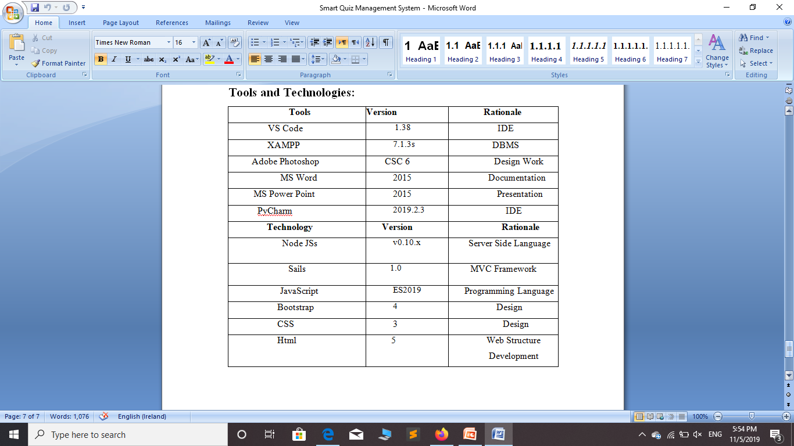
Tools and Technologies

Slide 13
Benefits
This can be used in institutions and in training centers as well as in corporate world.
As it is a web based application it can be used anywhere any time.
Manually checking will be reduced and teachers will save there precious time.

Slide 14
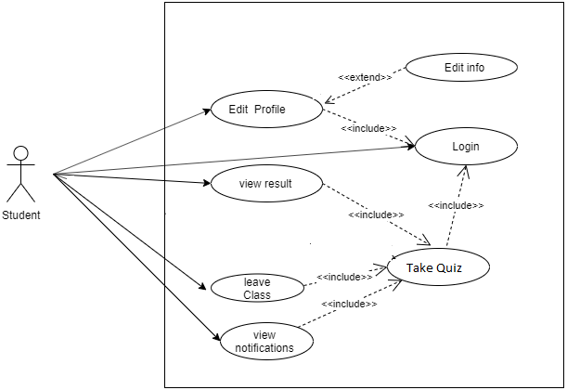
Usecase diagram of student

Slide 15
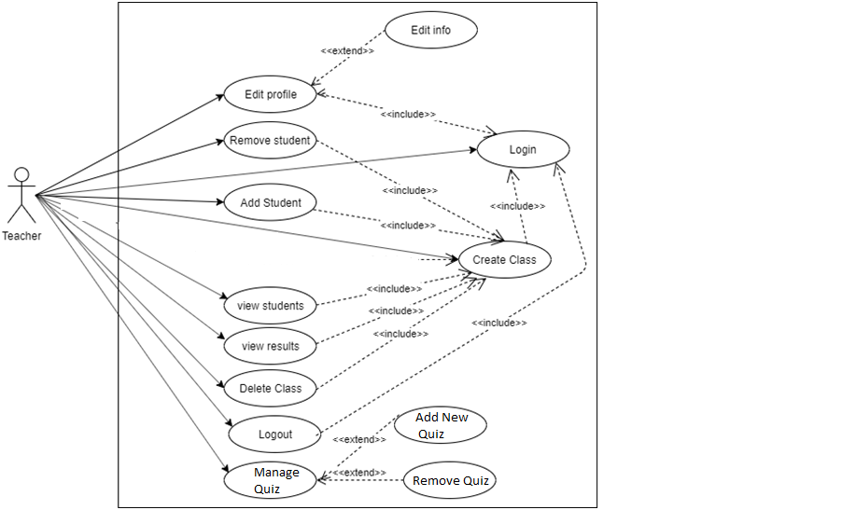
Usecase diagram of teacher

Slide 16
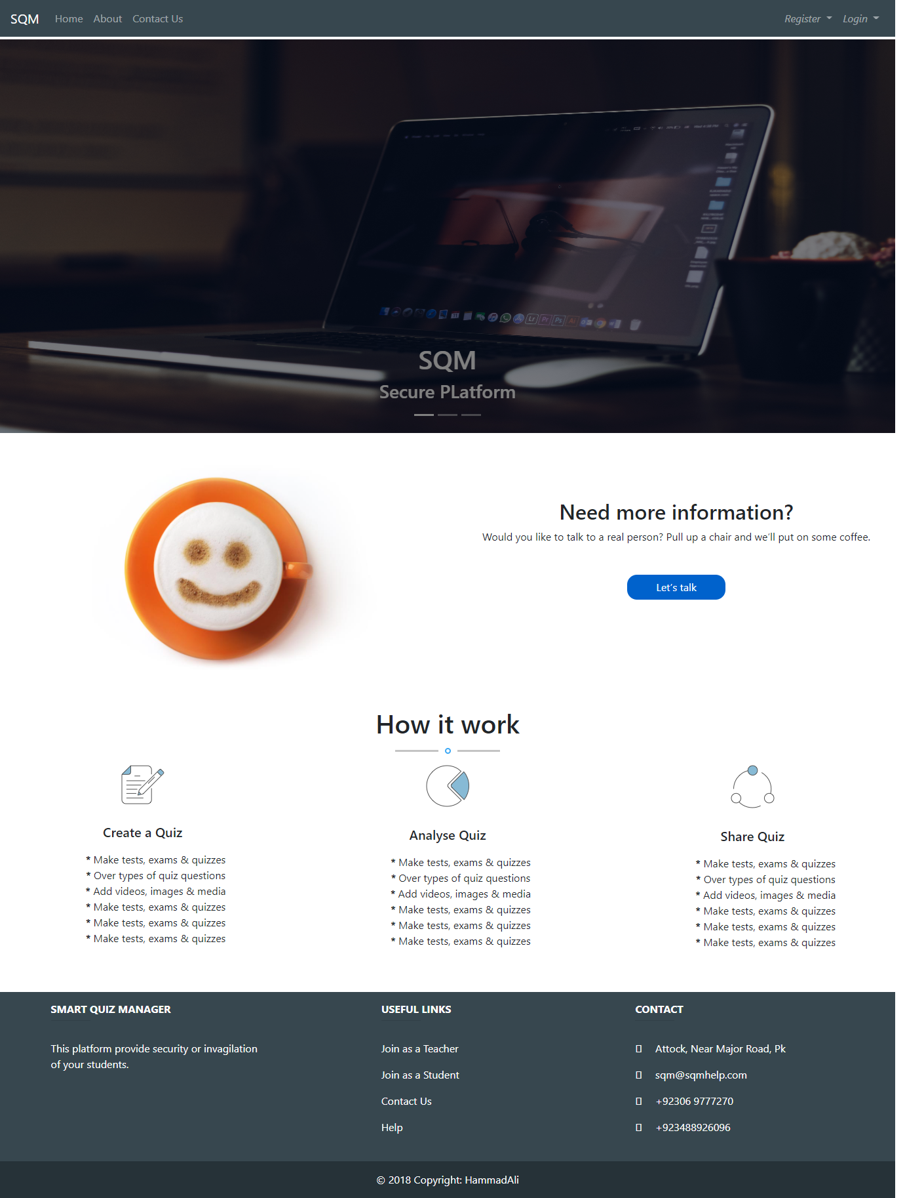
System screen shots

Slide 17
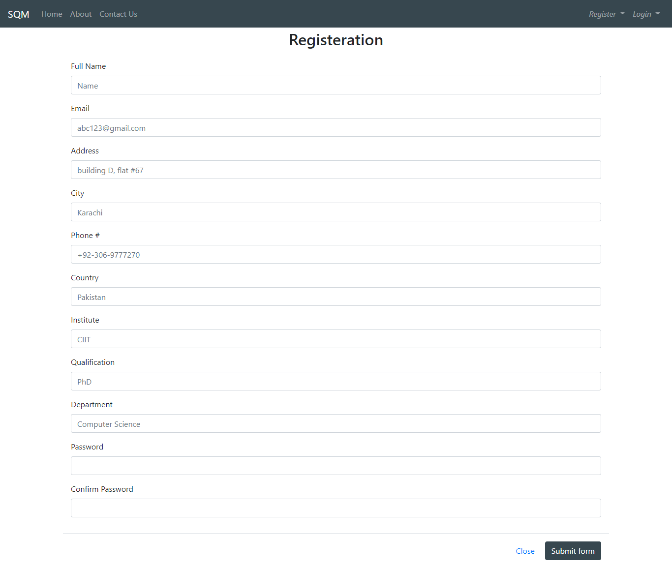

Slide 18
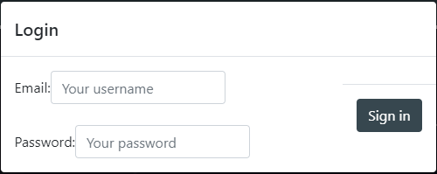

Slide 19
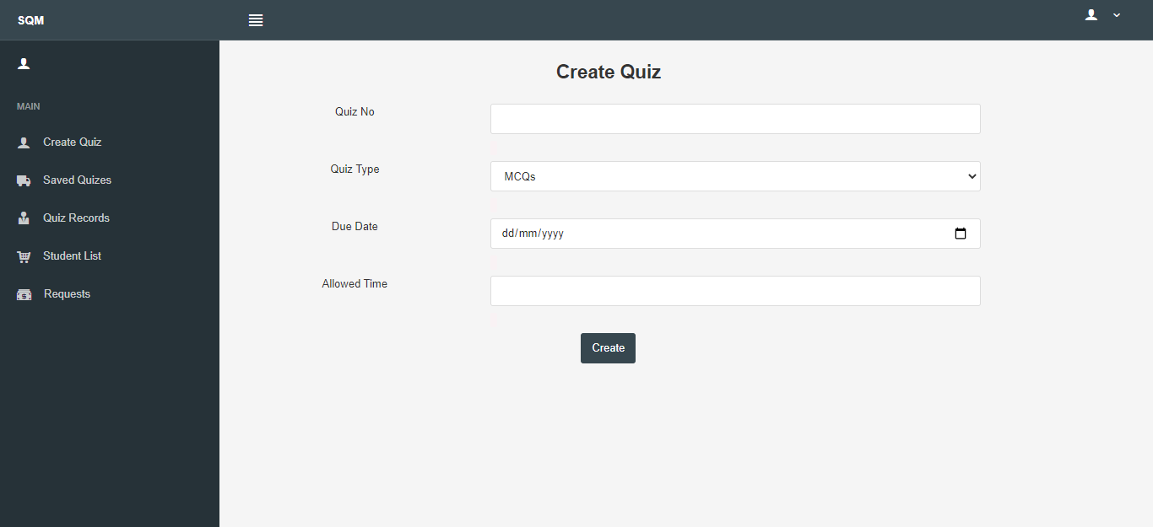

Slide 20
Future work
In future this project can be further extended in this we also add the functionality of auto quiz generation. It will generate questions dynamically by the selected topic of the teacher. This project can be further extended in this we also add the functionality of speaking and listening due to which student will also give answer of the voice question and also make its live recording for the teacher when students will open any other functionality for cheating. With the passage of time and advancement of technology many more functionalities can be added to the smart quiz manager.

Slide 21
Conclusion
The basic idea of this project was to control the cheating attempts during an online exam, save time, money and make easy examination system that cannot irritate teacher as well as student. We did this it in our project we make an easy approach to take quizzes and also work as a spy to control over the malpractices.

Slide 22
Thank you
Any questions??

